Slide 1



Cost Transparency with
BMC TrueSight Capacity Optimization
Rick Kickert, IT Planning Senior Manager
HCSC – Health Care Service Corporation
Notes:
Welcome,
This is BMC Global User Conference, engage 2014. Session 170, Cost Transparency with BMC TrueSight Capacity Optimization 9.5.
Presented by Mr. Rick Kickert, IT Planning Senior Manager for HCSC – Health Cares Service Corporation
http://bmc.g2planet.com/bmcengage2014/public_session_view.php?agenda_session_id=65

Slide 2
Agenda
Introducing HCSC Few data points
Capacity Management and Cost Transparency at HCSC Why the investment
TrueSight Capacity Optimization at HCSC Lesson learned and Best Practices
Q&A

Slide 3
Introducing HCSC
Few data points

Slide 4


Founded in 1936 and with more than 14.5 million members, HCSC is the largest customer-owned health insurer in the United States and fourth largest overall, operating through its Blue Cross and Blue Shield® Plans in Illinois, Montana, New Mexico, Oklahoma and Texas
We provide health coverage through our Blue Cross and Blue Shield Plans and dental, life and disability insurance through Dearborn National
We are greater than our 21,000+ employees, 60 local offices and state-of-the-art technology, including two Tier IV data centers — the industry's highest reliability level — that provide the speed and data security to meet our customers' current and future business needs
Health Care Service Corporation
Notes:
Data accurate to late 2014.
http://www.hcsc.com/

Slide 5
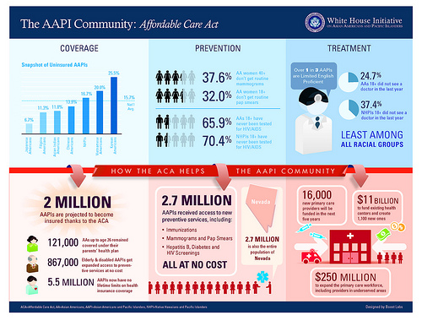


The Insurance Industry Changed... Why?
THE INSURANCE INDUSTRY CHANGED…..WHY?
03/23/2010
11/15/2013
TODAY
AFFORDABLE CARE ACT IS SIGNED
ENROLLMENT BEGINS FOR HEALTHCARE
MORE AFFORDABLE!
https://www.youtube.com/watch?v=sx2scvIFGjE
Notes:
The insurance industry changed. HCSC business model, which was based on groups, now included the individual market, which changed everything. Changed marketing, changed sales, changed billing, changed collection, added a check for subsidy eligibility (never before needed), changed adjudication rules, changed renewals, and HCSC had to maintain focus on existing lines of business. In short, it changed everything while maintaining what was.
Some key rules were undefined until after open enrolment started. Rules changed, the government site was not ready, vital processes did not work, work arounds did not work, but still the capacity had to be available to react to the business, which was quickly reacting in a volatile environment.
In the end, the situation was managed. And now open enrollment for the 2015 benefit year has its own challenges.
Six of One – Obamacare vs. The Affordable Care Act (4:00 minutes)
http://www.youtube.com/watch?v=sx2scvIFGjE
Jimmy Kimmel Live
Which do you think is better - Obamacare or the Affordable Care Act? They're the same thing, but that didn't stop people from weighing in...

Slide 6
Our vision
Drive competitive advantage via efficiencies and cost-effectiveness through IT optimization, simplification, and agile infrastructure & applications
“Provide the lowest cost, most accessible healthcare”

Slide 7
Capacity Management and Cost Transparency at HCSC
Why the investment?

Slide 8

Goals for Capacity Management at HCSC
Minimize our risk to production caused by capacity related outages and plan for growth
Reduce resource time used to manually collect and correlate data
Ensure models are aligned to business expectations and give IT runway to implement changes
Minimize future hardware spend by maximizing the utilization of our current investments
Process Optimizing
Business process view
Business Optimizing
Service view
Maturity
Performance Optimizing
Workload view
Fire Fighting
Monitoring
Component View
***
Outcome Focused
Execution Focused
Outcome Focused
Notes:
During the volatility of the Affordable Care Act, there were still the corporate goals to address. Minimize our risk to production, reduce time and effort to collect data, and align capacity to business expectations, while minimizing hardware spend by maximizing current investments.
This required a technology process to mature from exception based fire fighting, towards a more fact based, service view.

Slide 9

A phased approach to increase maturity and scope
Scope
Service
Component
Business
Claims, Calls, Benefits, etc...
Applications (eIVR, Portal, etc.)
MQ, Appliance, Middleware
Starting Point
HW, Network, Mainframe
Facility
Datacenter Efficiency
The all-around Capacity solution
Maturity
Starting point is always physical HW usage measurement
Two streams to increase maturity and scope:
Upwards (“classic”): accordingly to ITIL
Downwards (Green IT): to facilities and power consumption
Data Integration
Modeling
Planning
Reporting
4 Step Approach
Notes:
Choosing to ignore (for the moment) the datacenter services, We started with physical hardware, then moved ‘up’ to middleware, applications, then business metrics.

Slide 10


Step 1: Collect the data
Performance Insight
Web Trends
Network
Servers
BAM RSC / Portal
Public Site Hits / Visits
Databases
RSC
Hits / Visits
Producer Portal
Hits / Visits
Quest Performance Analysis
RSC Business Drivers
SQL
DB2
Oracle
eIVR Service Calls (IBI,ICI, IMI,IPI)
Wily Active Counts / Busy Workers: Public Site, Legacy, RSC
OPTIMIZED
NPI Crosswalk Service Call Counts
NetQoS Internet Circuit Utilization
BMC Atrium CMDB
DEFINED
V Center
CVP Call Voice Platform
eIVR – Ingress Gateway
Edgesite
VDI Counts
Monitoring tools
MANAGED
Business Drivers
BMC TrueSight
CAPACITY
OPTIMIZATION
CMM
NMON
Cacti
VPN counts
Member Liability Estimation
Edgesite
AP WEB Counts
DynaTrace
NetQoS
Aceyus
CVP counts
Real Time Adjudication Counts
NetQos
Application Bandwidth
Cisco Prime
Wifi Network
Real Time Benefits Transactions
Personnel Counts
CA Wily
Tivoli Productivity Center (TPC)
Sentinel
83X Transactions
Webex Ports Utilization
RTIS Mainframe Transactions
BMM
Cisco Prime
ODS
DMIH
Online Sales Channel
Notes:
TrueSight Capacity Optimization connects to many different data sources for device monitoring metrics, middleware metrics and business metrics. Gathering the data and making it available in one place allows for analysis on many different metrics and metric combinations.
ETL can be setup to nearly any source of structured data. While a database as a source is preferred, almost any data source can be used.

Slide 11
Step 2 & 3: Understanding Workload and Services
Services / Applications
Workload / Transactions
Components / Devices
Collected the data about Infrastructure
Needed to understand the workloads
Align Services with the components and workloads
Ready for Scenario Planning!!!

Slide 12
Planned Enrollment – Scenario Example
Insurance Industry Ad Campaign for change……

Slide 13
Planned Enrollment – Scenario Example
Healthcare.gov website delayed
Constant Re-Planning to adjust for Capacity needs
Constant Re-Planning to adjust for Capacity needs
Constant Re-Planning to adjust for Capacity needs
Constant Re-Planning to adjust for Capacity needs
Constant Re-Planning to adjust for Capacity needs
Constant Re-Planning to adjust for Capacity needs
Constant Re-Planning to adjust for Capacity needs
Constant Re-Planning to adjust for Capacity needs
Constant Re-Planning to adjust for Capacity needs
Constant Re-Planning to adjust for Capacity needs

Slide 14
Capacity Management - Maturity Levels
Process Optimizing
Business Process View, Report in Business Terms,
Measure Efficiency, Cost Benefit Analysis,
Business Optimizing (Service View)
Data Intelligence, Service Views, Scenario based Capacity Planning,
Influence usage via Cost Transparency , Service Costing
Performance Management (Optimizing)
Workload View, Data Integration, Predict Performance Issues, Trending,
Standardized Toolsets across Technologies, Understand Bottlenecks
Data Management (Monitoring)
Component View, Spreadsheets, Review Data as Needed, Siloed
Reactive (Fire Fighting)
Ad Hoc, Requests (calls, emails), No Predictive Analysis, Data Gaps, No Business Data, No View of Costs

Slide 15
Step 4: Adding Costs to the Equation
Services / Applications
Workload / Transactions
Components / Devices
Vision
Drive competitive advantage via efficiencies and cost-effectiveness through IT optimization, simplification, and agile infrastructure & applications.
Infrastructure Costs
“Provide the lowest cost, most accessible healthcare”
Notes:
Everything to now was strictly capacity planning and optimization but are critical first steps to cost transparency. This has the data in place, provides the consistent metrics needed to trigger a charge, creates the groupings to aggregate costs, creates the projects, applications and services to be costed, and lays the ground work to establish a pricing sheet.
ALL of these need to be in place and easily managed before a cost transparency effort should be started.

Slide 16
#1 Challenge - Understand Your Costs
Mainframe | Linux / Aix / Unix | Wintel | Storage | Network
Mip | Memory | Memory | GB / TB | Ports
Software Costs of Operating System
Human Capital Costs of Operating System
Understand your Consumption (Monitoring / CMDB / Bill of Materials)
Project Costs, Application Costs, Service Costs………
Notes:
Decide which infrastructure metrics are available, and which other costs should be included.
http://www.bmc.com/it-solutions/capacity-optimization.html
DMAIC (an abbreviation for Define, Measure, Analyze, Improve and Control) refers to a data-driven improvement cycle used for improving, optimizing and stabilizing business processes and designs. The DMAIC improvement cycle is the core tool used to drive Six Sigma projects. However, DMAIC is not exclusive to Six Sigma and can be used as the framework for other improvement applications.

Slide 17
#2 Challenge – Cost Alignment
CPU
Memory
Devices
Virtual Devices
Software
Servers
Disk
Virtual Tape
Tape
Labor
Replication
Storage
Ports
Labor
Plant Equipment
Power
Network
MIPS
Software
Labor
Mainframe
Notes:
Align the costs to the metrics.
A few dozen items will become self apparent but then resist adding more. The more you make, the more complicated to manage, and the more debate created. However, if there are not enough ‘levers’, then cost center owners will not have the ability to manage their ‘costs’.

Slide 18
#3 Challenge – Automation / Efficiency
100x
Increase
40x
Increase
3300
72x
Increase
Notes:
Automation allowed for quicker turn around and more accurate results.
Before TrueSight Capacity Optimization the capacity team of 7 could perform detailed analysis on about 300 infrastructure devices, (now 3300), about 5 business drivers, (now 90), and 4 applications or services (now 160) in a month. Now we routinely perform analysis on a few dozen in detail and ‘watch’ the 160 modeled apps and all equipment in the TrueSight Capacity Optimization tool in the same time.
We had a customer call at three in the afternoon with a request to decide if he could double his work mission with a new opportunity they were considering and how much extra equipment he would need. In two hours we informed him authoritatively that his systems had the capacity to double with room to spare and still maintain their expected service times. We show the charts and analysis notes and discussed the results. He took that analysis and went forward with his new opportunity without incurring infrastructure charges and indeed had sufficient capacity upon completion of the effort. Before TrueSight Capacity Optimization, this analysis would not have been performed, as this was not an application we had any information on, and the project would have incurred unnecessary infrastructure charges.

Slide 19
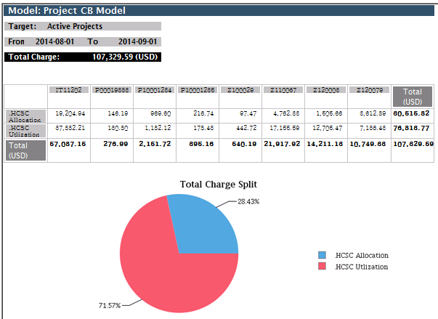
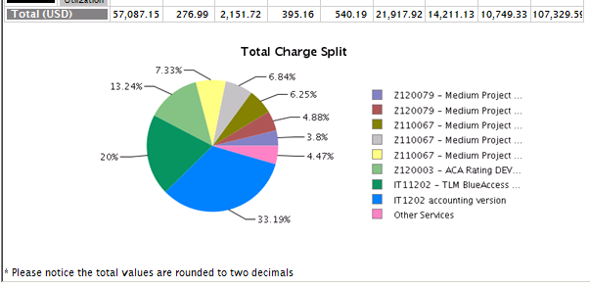
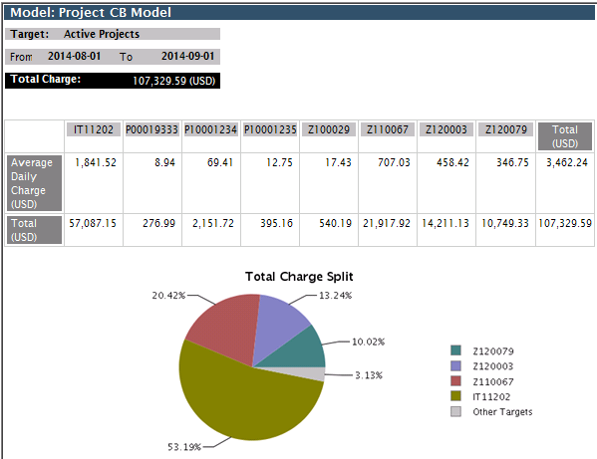
#4 Challenge – Reporting Views
Develop the appropriate reports to get value
Project Managers can track near real-time costs
Financial planning can use a report to track to budget
Corporate finance can use reports to ‘shift funds’ and allocate resources
Notes:
Develop the appropriate reports to get value for the various customers.
We incorporated the financial data into an efficiently report so application owners could see what opportunity cost they were incurring with the infrastructure allocations they have vs. what they are using.
Corporate finance takes finance data and uses that to ‘shift funds’ from a project to IT.
Project managers can see the data in near real time to see how they are tracing at any time, independent of the corporate finance reports. As they are based on the same data, there is no surprises, and ready access.

Slide 20

#5 Challenge – Adaptability
IT Groups
Verify IT Costs
Finance
Verify Financial Accuracy
Demonstrate Success
Report & Communicate
Cost Analysis
Reduce errors
Reduce Manual Effort
Must develop ‘Buy In’ on IT Costs
Establish Financial Accuracy
Reporting / Cost of Service / Cost Transparency
Demonstrate Opportunities & ROI

Slide 21
TrueSight Capacity Optimization at HCSC
Lesson learned and Best Practices

Slide 22
Lesson Learned
Here is a taste of what we learned:
We have our ‘how to’ document.
We will review, how to start, IF to start, lessons learned, a few warnings and a call to action.
When you choose to undertake cost transparency, the challenges are many, rewards are huge, and ability to affect significant change is almost guaranteed.
Notes:
We have an internal document (45 pages) we made when we were struggling with what we knew we knew and what we knew we did not know. As our understanding improved the document filled in.. It is an internal document, not intended to be published, so is a little rough / incomplete in places. It does cover our journey to less ignorant.
Leave us your card and we will forward the most recent version.
http://www.ignorance.medicine.arizona.edu/ignorance.html
What is ignorance? Known unknowns …
This presentation is the lessons learned along the way and is intended to help you decided IF you are going to do a cost transparency effort in TrueSight Capacity Optimization, and what to look out for along the way. The issues and observations are not complete, unique to our situation and your experience WILL BE DIFFERENT.
There is a reoccurring theme in our cost transparency adventure. There is so much to know before you get started, but you don’t know it until you get started. Some choices preclude future choices, other choices create future choices. You will not know which one is ‘best’ and in fact it is difficult to know that a choice has hidden other choices.
To solve for this, you need to do research, make several models, and get help from trusted, knowledgeable, advisors.
This will be difficult to “get right”.
Prepare for frustration.
Prepare to “do it over”.
Prepare to be a disrupting force.

Slide 23
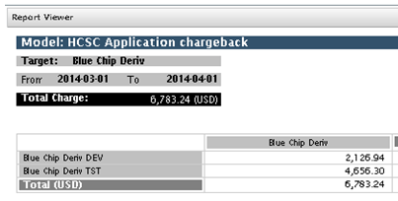
Start With The End In Mind
The cost transparency output will be an input to another process
We looked at project cost transparency, so wanted a project bill containing total charge, and broken out by environment, type of billable item, and other groupings.
The first attempt should be a process improvement exercise.
Notes:
Starting with the end in mind, what is the mission, deliverables, and data required.
The output of the cost transparency system is an input to other systems, processes and studies. This will go a long way to defining what is in scope, and more helpful, what is not in scope. These users will likely be your supporters. As the system is database driven, there a many views possible, and ways to put this new information to use (for good).
There is probably a cost accounting system of some sort already, so take a piece of that and do a process improvement operation on it. This will help define what the scope is, and more importantly what the scope is not. This customer will likely be an supporter. MANY others are not likely to be supporters.
The lessons learned will be easily adapted to the next effort.
Once our TrueSight Capacity Optimization install was about 6 months old we realized we had, or soon would have, the data required to do a cost transparency system, and the cost transparency process owner was begging to see if TrueSight Capacity Optimization could take over the manual work. We spend a week researching, then jumped in using two made up projects. It was a disaster. Instructions did not match our mission, we mis read documents, mis understood documents, did not find documents, or otherwise had trouble getting the system to do what we wished. Then got an intern, so used her for focused effort.
The output was our ‘what we know we know, and think we know’ document and a working cost transparency system.

Slide 24
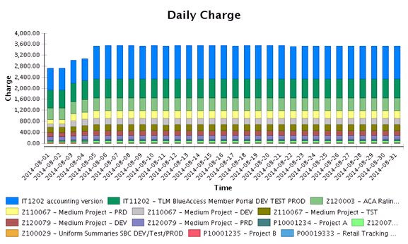
Notes:
We selected our (mostly manual, spreadsheet based) project cost transparency system as a starting point and played with only a few ‘fake’ projects to get the setup just the way we wanted. Then used the supplied charts to imagine what use case they would help satisfy. Then added real projects to compare the results.
The output looks like it will do what we wish, and we are formalizing the process to have TrueSight Capacity Optimization take over the cost transparency system as of the first of the year.
https://docs.bmc.com/docs/display/public/bcmco95/Chargeback+metrics
Advanced Report templates

Slide 25
Should You Do Cost Transparency?
NO, unless you:
Have a clear use case for cost transparency.
Can maintain the associations automatically.
Have consistent, available, appropriate metrics with which to trigger a charge.
Are committed to taking action on the results of the cost transparency system.
Notes:
You should NOT do cost transparency UNLESS each of these statements are true, or you actively mitigate the risks implied by the questions.
Have a clear use case for cost transparency (with appropriate SENIOR level ACTIVE support).
Can maintain the associations automatically.
Have consistent, available, appropriate metrics with which to trigger a charge.
Are committed to taking action on the results of the cost transparency system.
This may surprise you but…
I would generally recommend against doing a cost transparency system. There is a considerable upside to cost transparency, but that upside is exceptionally dependent of having complete data, maintenance process, and a clear mission statement complete with built in users.
To the extent that there is a question of ‘is cost transparency worth pursuing?’ suggests that the requirements have not been met. There will be a ‘magic point’ where cost transparency is just a no brainer. All the data are available, there is a mission with a willing customer, and sufficient management support.
You would be well served to wait until these things are in place.

Slide 26
General Lessons Learned
Cost transparency is hard! Decisions and results will make people mad.
You are doing cost transparency now, so treat your FIRST implementation as a process improvement effort.
Cost transparency should DRIVE BEHAVIOR.
The biggest threats are political, cultural, and inertia. And the status quo.
Strive for a useful, consistent, lie, rather than “truth”.
Price is easy, using Target Return Pricing*.
Notes:
Cost transparency in hard! Decisions need to be made that will make people mad. - Cost transparency is disruptive and will have powerful forces supporting and apposing the effort.
You are doing cost transparency now, so treat you FIRST implementation as a process improvement effort. This is far less threatening but still packed with conflict. – start small and grow as results mature. We spent WEEKS on cost transparency with ZERO useable results. Then in a few days applied what we learned to our target of project cost transparency for half a dozen projects. Then in 90 seconds (no kidding) applied it to 125 applications, and all of the environmental versions of the applications.
Cost transparency should result in actionable intelligence. That is to say, DRIVE BEHAVIOR. – Actionable intelligence should result in ACTION, which includes willful inaction.
Cost transparency is an inerative process. – After each round there will be ‘better’ metrics to trigger a charge. Only allow this to the extent that it is useful. Good enough is, good enough. Remember, this is a useful, consistent lie. Perfect is an expensive illusion.
The biggest threats are political, cultural, and inertia. Way down the list are data availability, technology, and implementation difficulty.
It helps to abandon the goal of ‘truth’. There is very little truth in real life, only useful, consistent, lies. For example, what time is it (right now). My clock said 2:33 but that is a lie. It is actually 07:33:47.987345 per US Naval Observatory Master Clock UTC… or 14:33 Central Time (24 hour clock). Even if you chose a time lie, you are then faced the definition of the sentence. Is ‘right now’ when we started or finished the question? Or the time the question was received by the noun expected to answer? Or did they fudge and adjust the answer to coincide to when we were expected to get the answer? The closer you look, the fewer use cases actually depend on the nuance of the ‘truthful’ answer. So in the cost transparency model of TrueSight Capacity Optimization how much something costs has a string of qualifiers attached and should be regarded as a useful, consistent, lie.
http://tycho.usno.navy.mil/cgi-bin/timer.pl
Costs will create a HUGE issue. We could discuss this for hours but, in keeping with the useful consistent lie, think of it this way: What is you cost transparency recovery target? Then as a completely separate thought you able to account for in cost transparency system. That is the items you are charging for and how many of them can you ‘sell’. Then do the math (simple division).
I need to recover 100,000 dollars a year. I can account for 100 named servers, in each of the 12 months. That makes 100,000 dollars divided among 1,200 machine months. That makes each one cost $83.33 a month. Target Return Pricing.
This conversation does not concern itself with how much a named server actually costs to produce, only how much do to recover, and how many things can be used to recover that much. This is foreign to us, as it is a business type conversation and not a technical conversation, that is partly why the conversation feels, unfair or dirty to technical people.
http://www.businessdictionary.com/definition/target-return-pricing.html
Emotion is a fearsome opponent of logic and reason and facts.

Slide 27
TrueSight Capacity Optimization
Best Practices
Structure of the Workspace is critical.
Metrics must be ‘universal’.
Allocations should drive the system.
Pricing is easy, sans the politics.
Cost transparency is EASY, when built on a solid foundation.
Notes:
Structure of the workspace is critical. It MUST be consistent, so to accommodate the many missions the layout must serve, it must be well thought out.
Maintaining the structure, beyond a few entries must be automated.
Metrics must be universal to the metric you intend to use. For example if system type + brand + model is used to trigger a charge ( Switch + Cisco + 5020) then all switches of type cisco model 5020 must report that data. Alternate example, if you charge for memory installed for all servers, all servers must report the memory installed metric.
You should charge on what is assigned to the device rather than what the device actually uses. Storage is a good example. Ask for a 300 GB drive get charged for 300 GB even when you only ‘use’ 50 GB.
Pricing is easy minus the politics. There can be several cost models EACH with their own rate card. Remember: What to recover / number billable = cost. Arriving at the what to recover can be political so can create problems.
The status quo is emotionally involved so immune to logic and reason and facts.
Cost transparency is easy, if built on a solid foundation. Avoid implementing prematurely. Be sure the need exists to do a cost transparency system, you have the commitment to maintain the system, and are willing to let hostile people review what you are doing, and not doing. That is the nature of financial types.

Slide 28
What Can KILL A Cost Transparency Effort?
Sayers of NAY! and FUD Dragons.
Inattention.
Illusory superiority in you and others.
Do NOT let it become a super detailed accounting effort.
Notes:
Nay, the English spelling of Danish nej "no". There are people that will say “no” to anything new. This is especially true with a disruptive new technology. A nay sayer in a position of authority can be detrimental to the cost transparency effort directly, or impede one of the critical components. Don’t take a ‘no’ from anyone that cannot tell you yes, insist they pass it to higher authority.
FUD Dragons, a Benism (made up word by Mr. Ben). Intended to represent the people that use FUD.
http://en.wikipedia.org/wiki/Fear,_uncertainty_and_doubt
“FUD is generally a strategic attempt to influence perception by disseminating negative and dubious or false information.”
The people that use FUD wish you to imagine a dangerous dragon where there is none. Most times there are no facts supporting FUD Dragons, and the people that create FUD generally turn out to be punks and bullies that cannot stand a fact based conversation. Occasionally, however they can out maneuver you, and take your lunch money. Slay these FUD Dragons as quickly as possible, as the perception of reality becomes reality, even when based in FUD.
Inattention, a cousin of sloth, one of the seven deadly sins, which can kill your efforts.
Inattention or poorly handling the politics can kill the effort, or burden it under bureaucratic or procedural load sufficient to collapse the effort. Cost transparency is an active enemy of the status quo, and will find enemies, literally everywhere. (see FUD Dragons)
You can derail yourself with lack of preparation or thinking the cost transparency will eventually run itself. cost transparency is hard, disruptive, sensitive, and in constant need of diligence.
Illusory superiority in you and others will feed the enemies of cost transparency, and cause you to underestimate the difficulty, or the motivation of foes, and overestimate your abilities. Accept that you are guilty of this, and take care to minimize the effect by being aware that it is present.
http://en.wikipedia.org/wiki/Illusory_superiority
Illusory superiority is a cognitive bias that causes people to overestimate their positive qualities and abilities and to underestimate their negative qualities, relative to others. This is evident in a variety of areas including intelligence, performance on tasks or tests, and the possession of desirable characteristics or personality traits
Do not let cost transparency become the place to do DETAILED billing accounting. Remember the useful, consistent lie. Let cost transparency figure the bill based on facts in evidence, then handle exceptions in the followon process, and definitely do not try to account for exceptional exceptions. Simple, clean, understandable, cost transparency.

Slide 29
Commence Disruption / Value Add
Cost transparency is disruptive. Guide it the affect a real change, and cascading change, “trophic cascade”.
Power structures will be perturbed and will resist.
You will be able to answer resource allocation questions in business terms.
You will be able to inform choices based on common denominators, that is to say, money.
You will go a long way to letting the business understand their requests in a way they can relate to - Cost vs. Benefit to the business goal.
Notes:
If all of the elements are in place and you decide to undertake cost transparency, you stand to gain huge benefits beyond simple cost transparency. The act of charging based on consumption is disruptive to the entire decision making eco system. There will be unintended consequences, including overtly bad ones, but there will also be unintended consequence's that are overtly positive, and not easily relatable directly to cost transparency.
As the disruption is anticipated, or starts to actually happen, people that may have supported, you may now be threatened. The status quo hates you. Be diligent. You will find cost transparency to be an agent of change that is trophic cascade of change.
http://blog.ted.com/2014/02/18/video-how-wolves-can-alter-the-course-of-rivers/
George Monbiot poetically explains how reintroducing wolves to Yellowstone National Park after a 70-year absence set off a “trophic cascade” that altered the movement of deer, sent trees soaring to new heights, attracted scores of new animals to the area (think: beavers, rabbits, bears, bald eagles and more), and stabilized the banks of rivers making them less susceptible to erosion.
However, you will find that questions that could not be answered in the past are now answerable. The old application costs 50,000 a month in old hardware support costs but only brings in 400,000 a year in revenue. To the good corporate citizens, you are now a hero, to the status quo of the application, you are a mortal enemy.
You will be able to show that the policy that said every ‘critical application’ must have 100% duplicate systems in DR, can now be shown to have a significant cost. Good corporate citizens tend to make better corporate decisions when complete information is available. Now with the perceived value of the rule, someone can enforce that rule with a more complete picture of the actual cost, and perceived cost, vs the actual benefit, and perceived benefit.

Slide 30
Review and ‘What Now?’
Start with the end in mind
Should I do Cost Transparency?
Lessons Learned
Commence Disruption / Value Add
Review / Questions / Resources
- Take Action NOW-
Notes:
This presentation was about creating actionable intelligence with cost transparency. You should have a fairly clear idea IF you will pursue a cost transparency effort based on this presentation, the handout, and the questions and answers. So take action, even if it is willful inaction on creating a cost transparency system.
I would generally recommend against doing a cost transparency system. There is a considerable upside, but that upside is exceptionally dependent of having complete data, maintenance process, and a clear mission statement complete with built in users. To the extent that there is question that cost transparency is worth pursuing suggests that the requirements have not been met. There will be a ‘magic point’ where cost transparency is just a no brainer. All the data are available, there is a mission with customer, and sufficient support.
You would be well served to wait until these things are in place.
So now it is your turn. Take action. Action includes informed, willful, inaction.

Slide 31




Rick_kickert@bcbsil.com
Thank You.
http://www.linkedin.com/in/rickkickert/

Slide 32
Resources
Leave your card and we will email you this presentation, and our document
The cost transparency example document
BMC support people – very useful
BMC documentation
BMC peer help communities – becoming more helpful
BMC Strategic partners / vendors – very useful
Notes:
cost transparency example document…
BMC Support – per your support contract. Use it.
TrueSight Capacity Optimization 9.5 documentation
https://docs.bmc.com/docs/display/public/bcmco95/Home
BMC peer help communities. These are helpful to the extent they are used, and used to the extent they are helpful.. You should help yourself by helping others.
BMC Strategic Partners. We used Moviri. While ‘expensive’ was quite worth it. TrueSight Capacity Optimization is an exceptionally complex, powerful, tool that does so much more than capacity optimization. Moviri has been with TrueSight Capacity Optimization since the beginning and they showed me a lot. As a relative newbie, I showed them as well, which goes to suggest that TrueSight Capacity Optimization is way to big to do effectively on your own.
http://www.bmc.com/it-solutions/capacity-optimization.html

